Slide 1
Online Edu. Employment (Android)
Project Plan
VEL team
14 Aug. 2015

Slide 2
Project Plan
Agenda
1. Team VEL
2. Product Owner
3. Project Goal & Major Capability
4. Product Backlog
5. Development Plan
6. Scrum PM Tool
7. One User Story
8. Risk Management

Slide 3
1. Team VEL

Slide 4
2. Product Owner

Slide 5
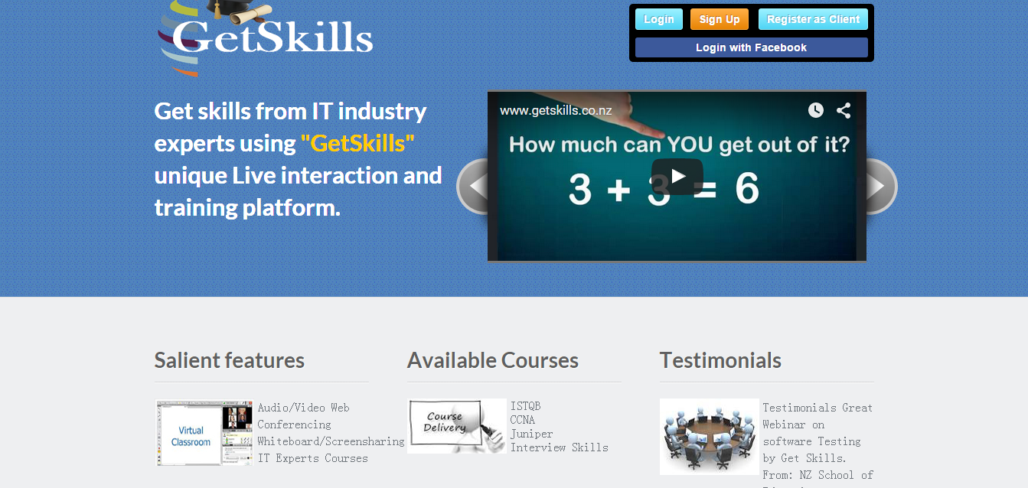
3. Project Goal and Major Capability
getskills.co.nz/

Slide 6
3. Project Goal and Major Capability
Major Capabilities:
1) Visitor ----- view the website, scan the course list, take a test without registering
2) System (course advisor) ---- give the user a short survey, give a list of successful examples, recommend some suitable courses
3) User ---- select courses, make payments online, take courses via video or audio

Slide 7
4. Product Backlog

Slide 8
5. Development Plan

Slide 9
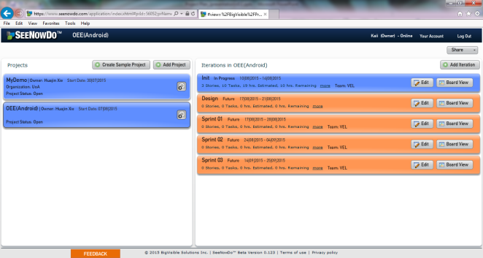
6. Scrum PM Tool (1)
SeeNowDo
URL: https://www.seenowdo.com/pages/login/index.html
Project Name: OEE(Android)
Image of project list & iteration list

Slide 10
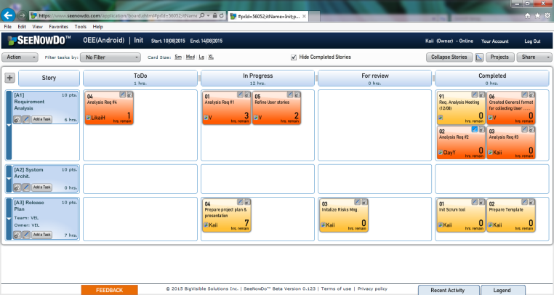
6. Scrum PM Tool (2)
SeeNowDo
Image of User Stories and Tasks List of one sprint

Slide 11
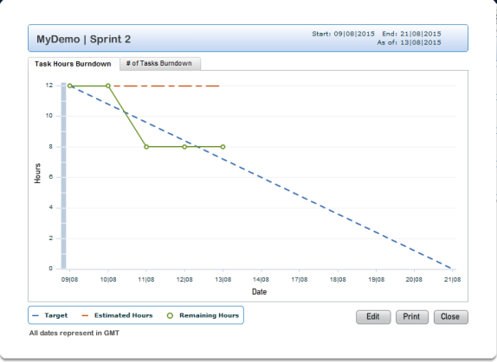
6. Scrum PM Tool (3)
SeeNowDo
Image of Burn-Down Chart

Slide 12
7. One User Story (1)
User story #1
As visitor, when I use mobile devices (phones and pads) to access the website, I want to see that the framework (the header, footer and buttons) of this website is suitable for my using behavior on mobile devices
So that I can use this website on mobile devices as convenient as on PCs.

Slide 13
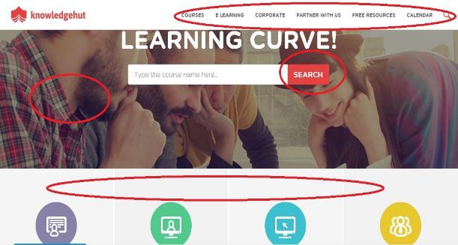
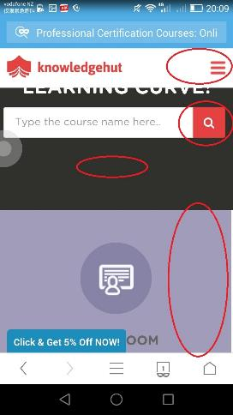
7. One User Story (2)
The menu, button, picture and layout may change from PC to phones.

Slide 14
7. One User Story (3)
User story #1
As visitor, when I use mobile devices (phones and pads) to access the website, I want to see that the framework (the header, footer and buttons) of this website is suitable for my using behavior on mobile devices
So that I can use this website on mobile devices as convenient as on PCs.
Device type detection
DPI & resolution detection
Dynamically changing style

Slide 15
8. Risk Management

